Slide 1






Doctor-Patient Appointment System
PROJECT NAME
Team Members: SUGURU SAI GANESH KOPPOKU SUDHEER BABU YASWANTH KANDERI
Guide:
UMA MAHESHWARI
Disclaimer: The content is curated for educational purposes only.

Slide 2
OUTLINE
PROJECT NAME
Abstract
Problem Statement
Aims, Objective & Proposed System/Solution
System Design/Architecture
System Development Approach (Technology Used)
Algorithm & Deployment
Conclusion
Future Scope
References
Video of the Project

Slide 3
Abstract
PROJECT NAME
The Doctor-Patient Appointment System is a comprehensive platform designed to facilitate seamless interactions between doctors, patients, and administrators. Doctors can efficiently manage their appointments, change passwords for security, provide health suggestions to patients, and maintain their patient lists. Patients, on the other hand, can log in securely, book appointments with their preferred doctors, and log out to ensure privacy.
Administrators play a crucial role in overseeing the entire system. They can manage patient and doctor accounts, handle queries from both parties, and ensure the addition of new doctors and specialties. The system emphasizes security and privacy, ensuring that sensitive information is handled securely at every step.
Overall, the Doctor-Patient Appointment System aims to streamline the healthcare process, making it convenient for all parties involved while adhering to data protection regulations and providing a user- friendly experience.

Slide 4
Problem Statement
PROJECT NAME
Develop a Doctor-Patient Appointment System to streamline healthcare interactions. The system should enable doctors to manage appointments, provide suggestions, and maintain patient records. Patients should easily book appointments, while administrators oversee account management and query resolution. Prioritize security, user-friendliness, and compliance with healthcare regulations.

Slide 5
Aim and Objective
PROJECT NAME
Aim:
To create a robust and user-friendly Doctor-Patient Appointment System that optimizes healthcare
interactions.
Objective:
The system aims to enhance appointment scheduling, facilitate secure communication between
doctors and patients, and provide administrators with effective tools for managing accounts and
addressing queries, all while ensuring compliance with healthcare regulations.

Slide 6
PROJECT NAME
Proposed Solution
User-Friendly Interface:
Intuitive interfaces for doctors, patients, and administrators to ensure ease of use.
Appointment Management:
Efficient scheduling for patients and easy appointment viewing for doctors. Confirmation and rejection mechanisms for doctors, with automated reminders. Secure Communication:
A secure messaging system for doctors to provide suggestions and communicate with patients.
User Account Management:
Options for doctors to add and delete patients, and for administrators to manage patient and doctor accounts.
Authentication and Authorization:
Robust authentication mechanisms to ensure data security.
Role-based authorization for doctors, patients, and administrators.
Search and Filter Functionality:
Search and filter options for patients to find doctors based on specialties and availability.
Feedback and Ratings:
Patient feedback and rating system for doctors to enhance transparency and decision-making.
Admin Dashboard:
An admin dashboard for managing doctors, patients, specialties, and handling queries.

Slide 7
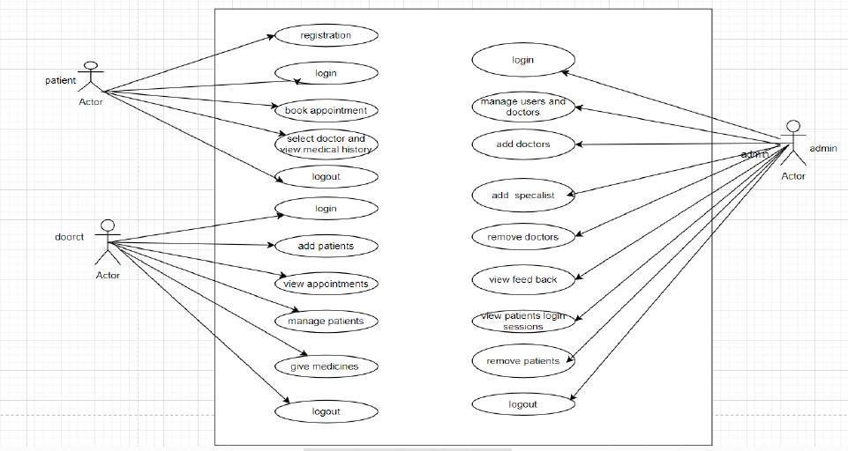
System Architecture
PROJECT NAME

Slide 8
System Deployment Approach
PROJECT NAME
Gradual Rollout:
Deploy the Doctor-Patient Appointment System in phases, starting with a limited user group, to monitor and address any issues before full-scale implementation.
Continuous Monitoring and Iteration:
Implement a robust monitoring system in the production environment for ongoing performance evaluation. Continuously iterate on the system based on user feedback and evolving requirements.

Slide 9
PROJECT NAME
Algorithm & Deployment
Appointment Scheduling:
Use scheduling algorithms (e.g., priority-based scheduling or first-come-first-served) to efficiently allocate available time slots based on doctor availability and patient preferences.
Search and Filtering:
Implement search algorithms (e.g., binary search) to quickly find doctors based on specialties or specific criteria, enhancing the user experience.
Security:
Utilize encryption algorithms (e.g., AES or RSA) to secure sensitive data during transmission and storage, ensuring the confidentiality
and integrity of patient information.
Load Balancing (if applicable):
Employ load balancing algorithms to distribute incoming traffic evenly across servers, optimizing system performance and resource utilization.
Sorting (e.g., for appointment lists):
Apply sorting algorithms (e.g., quicksort or mergesort) to arrange appointment lists chronologically or based on other criteria for easy
retrieval and display.
Notification System:
Use efficient notification algorithms to ensure timely delivery of appointment reminders or other critical messages to patients and doctors.
User Authentication:
Employ secure authentication algorithms (e.g., bcrypt or Argon2) to safeguard user credentials and prevent unauthorized access.
Data Retrieval (e.g., patient details):
Implement efficient data retrieval algorithms (e.g., indexing or caching mechanisms) for quick access to patient details, especially in
scenarios where large datasets are involved.

Slide 10
Conclusion
In conclusion, the development of a Doctor-Patient Appointment System is poised to significantly enhance the efficiency and accessibility of healthcare services. By incorporating user-friendly interfaces, advanced security measures, and emerging technologies, the system can streamline appointment scheduling, facilitate secure communication, and contribute to an overall improved patient-doctor experience.
PROJECT NAME

Slide 11
Future Scope
PROJECT NAME
Telemedicine Integration:
Integration of telemedicine features to enable virtual consultations, expanding access to healthcare
services and accommodating remote patient-doctor interactions.
Artificial Intelligence (AI) Integration:
Incorporating AI algorithms for predictive analysis, personalized health recommendations, and optimizing appointment scheduling based on historical data and trends.
Blockchain for Security:
Implementing blockchain technology to enhance data security and integrity, ensuring transparent and
tamper-resistant healthcare records.

Slide 12
Reference
PROJECT NAME
https://www.researchgate.net/publication/312946008_Mr_Doc_A_Doctor_Appointment_Application_Syst
em

Slide 13
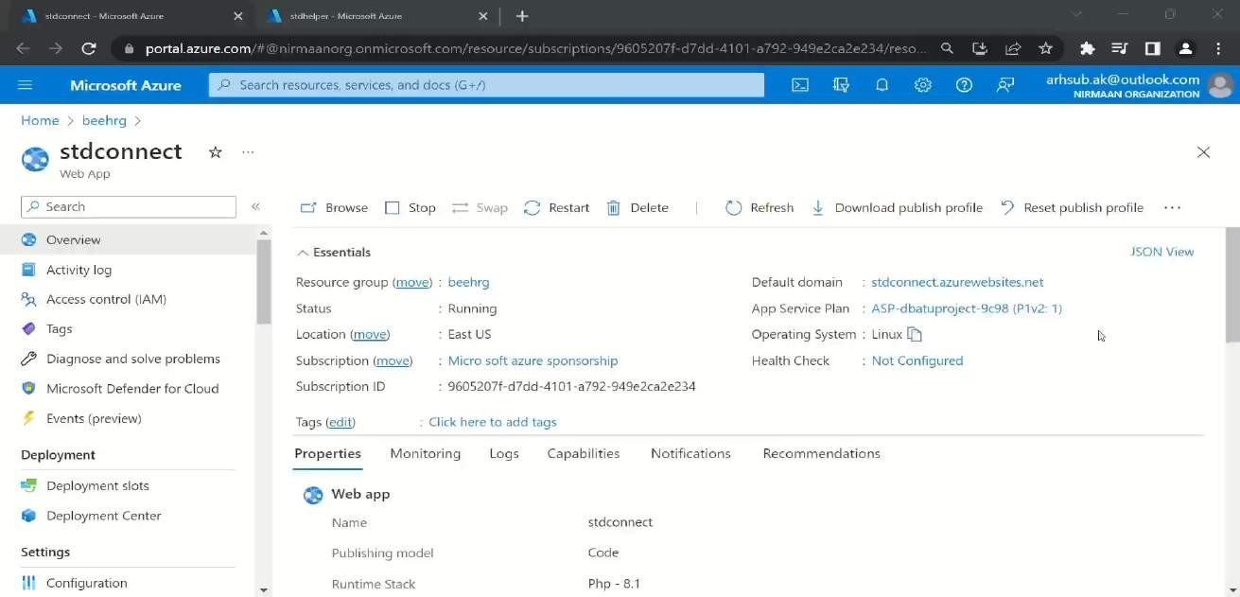
PROJECT NAME

Slide 14
Thank you!
PROJECT NAME

